Slide 1
Project Procurement and Contract Management
DR. M ASGHAR MUGHAL
Lecture 3

Slide 2
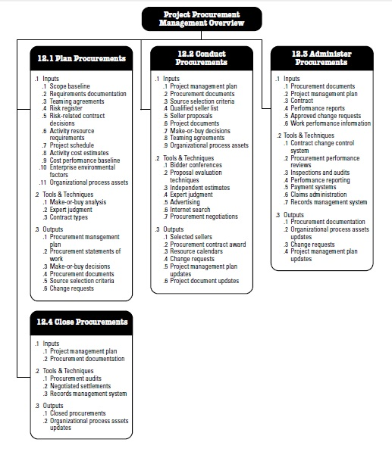
Project Procurement Management Overview

Slide 3
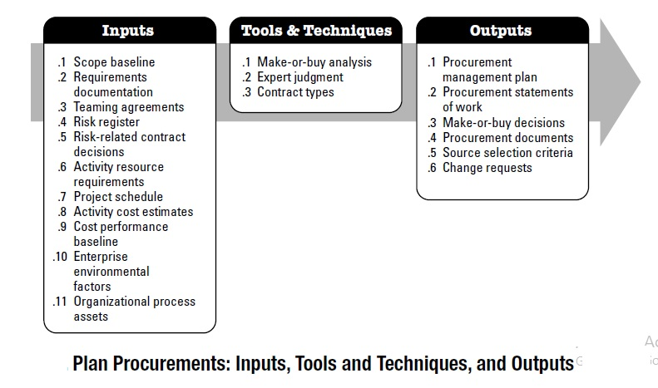
Planning Procurement

Slide 4
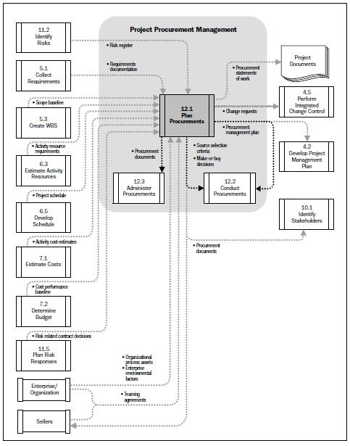
Procurement Planning Flow Chart

Slide 5
PROCUREMENT ADVERTISEMENTS
PPRA RULES
12. Methods of advertisement.-
(1) Procurements over **five hundred thousand Pakistani Rupees and up to the limit of ***three million Pakistani Rupees shall be advertised on the Authority’s website in the manner and format specified by regulation by the Authority from time to time. These procurement opportunities may also be advertised in print media, if deemed necessary by the procuring agency:

Slide 6
(2) All procurement opportunities over **three million Pakistani Rupees should be advertised on the Authority’s website as well as in other print media or newspapers having wide circulation. The advertisement in the newspapers shall principally appear in at least two national dailies, one in English and the other in Urdu.
(3) In cases where the procuring agency has its own website it may also post all advertisements concerning procurement on that website as well.
(4) A procuring agency utilizing electronic media shall ensure that the information posted on the website is complete for the purposes for which it has been posted, and such information shall remain available on that website until the closing date for the submission of bids.
13. Response time.-
(1) The procuring agency may decide the response time for receipt of bids or proposals (including proposals for pre-qualification) from the date of publication of an advertisement or notice, keeping in view the individual procurement’s complexity, availability and urgency. However, under no circumstances the response time shall be less than fifteen ***days for national competitive bidding and thirty ***days for international competitive bidding from the date of publication of advertisement or notice.

Slide 7
All advertisements or notices shall expressly mention the response time allowed for that particular procurement along with the information for collection of bid documents which shall be issued till a given date, allowing sufficient time to complete and submit the bid by the closing date:
Provided that no time limit shall be applicable in case of emergency.
(2) The response time shall be calculated from the date of first publication of the advertisement in a newspaper or posting on the web site, as the case may be:
*Provided that for all procurements up to three million Pakistani Rupees, the response time shall be considered from the date of appearance of the advertisement on the Authority’s website.
(3) In situations where publication of such advertisements or notices has occurred in both electronic and print media, the response time shall be calculated from the day of its first publication in the newspapers.

Slide 8
Plan Procurement: Inputs

Slide 9
Input 1: Scope Baseline
“The Scope Baseline describes the need, justification, requirements and current boundaries for the project”
Scope Statement
Work Breakdown Structure (WBS)
WBS Dictionary

Slide 10
Scope Statement
Definition: The project scope statement contains the product scope description, service and result description, the list of deliverables, and acceptance criteria, as well as important information regarding technical issues or concerns that could impact cost estimating. Examples of constraints are required delivery dates, available skilled resources, and organizational policies.
Scope Creep: Large changes in scope are easily identified. It is the "minor refinements“ that eventually build to be major scope changes that can cause problems. These small refinements are known in the field as scope creep.
Procurement of Project Scope: Who will be performing the various segments of the project, particularly that work which will be purchased from outside the company.

Slide 11
Work Breakdown Structure (WBS)
Definition:
  “Deliverable oriented hierarchical decomposition of the work to be executed by the project team." The work breakdown structure visually defines the scope into manageable chunks that a project team can understand, as each level of the work breakdown structure provides further definition and detail.
  The work breakdown structure acts as a vehicle for breaking the work down into smaller elements, thus providing a greater probability that every major and minor activity will be accounted for.

Slide 12
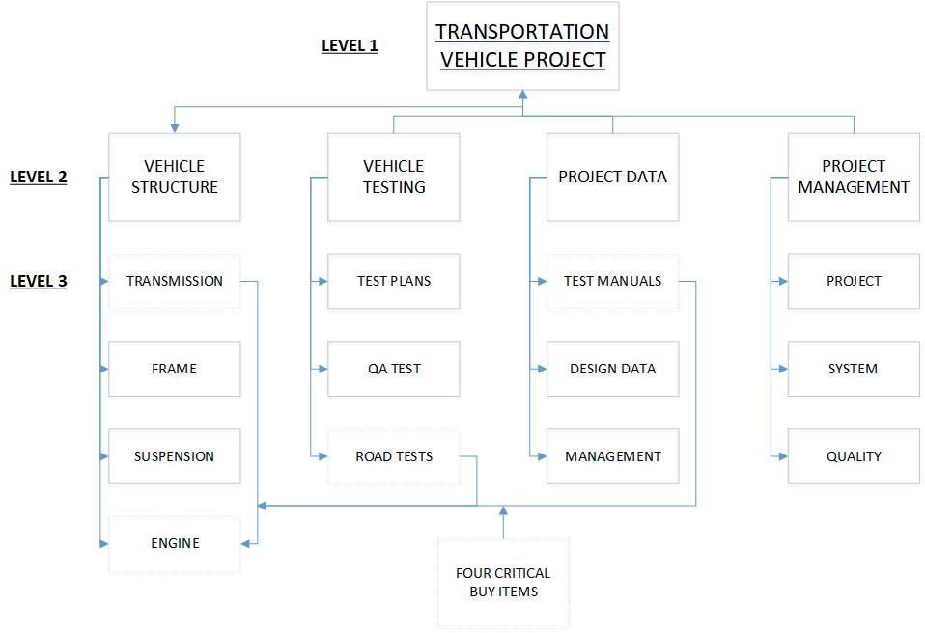
WBS: Vehicle Development

Slide 13
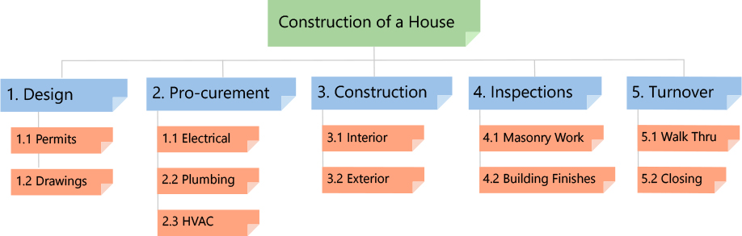

Slide 14
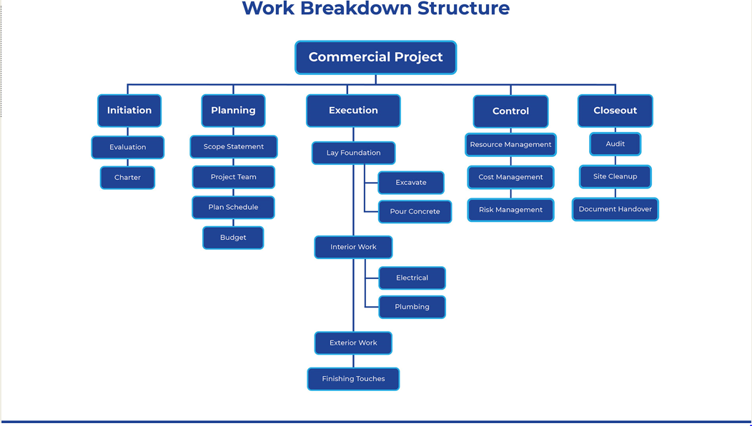

Slide 15
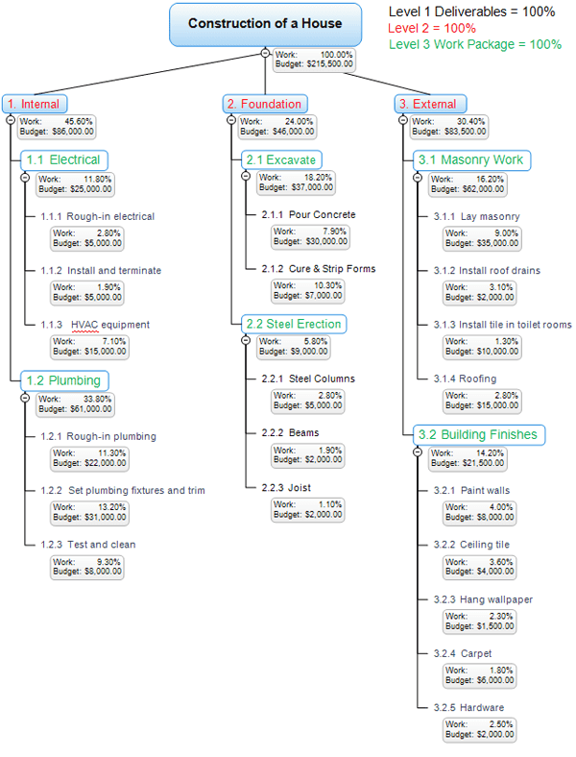
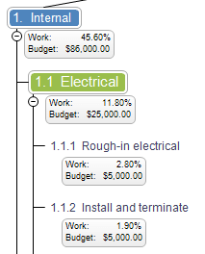
WBS: Construction of House

Slide 16
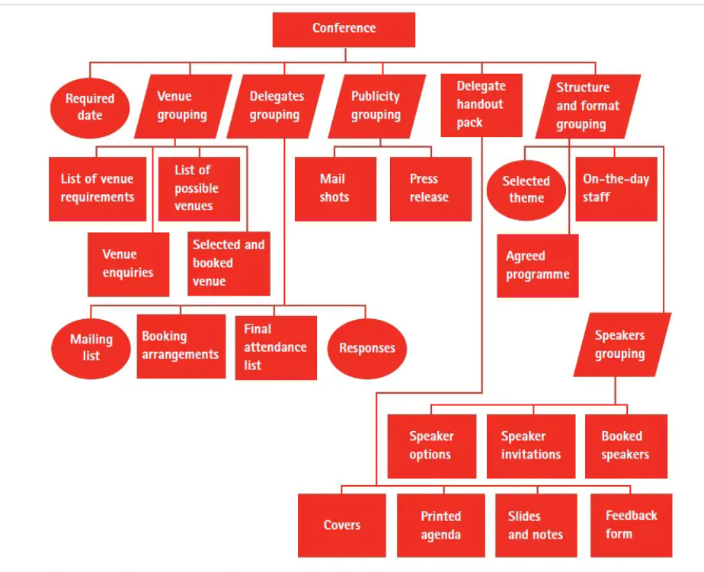

Slide 17
Input 2: Requirements Documentations
Important information about the project requirements that is considered during planning for procurements
Requirements with contractual and legal implications that may include health, safety, security, performance, environment, insurance, intellectual property rights, equal employment opportunity, licenses and permits- all of which are considered when planning for procurements.
Input 3: Teaming Agreements:
Assessing requirements for the formation of consortiums, joint ventures, partnerships or some other arrangements as defined by the parties.
When ever a teaming agreement is in effect, the roles of buyers and seller are predetermined, and such issues as scope of work, competition requirements and other critical issues are generally predefined.

Slide 18
Input 4: Risk Register
List of identified risks:
  The identified risks are described in as much details as possible. A simple structure for risks in the list may be applied, such as EVENT may occur, causing IMPACT, or if CAUSE, EVENT may occur, leading to EFFECT.
List of Potential Responses:
  Potential responses to risk may sometimes be identified during Identify Risk process.
Input 5: Risk Related Contract Decisions
Risk related contract decisions include agreements including insurance, bonding, services, and other items as appropriate.

Slide 19
Input 6: Activity Resource Requirements
Activity resource requirements contact information on specified needs such as people, equipment, or location
Input 7: Project Schedule
Project schedule contains information on required timelines or mandated deliverable dates.
Input 8: Activity Cost Estimates
Cost estimates developed by the procuring activity are used to evaluate the reasonableness of the bids and proposals received from potential suppliers.
Input 9: Cost Performance Baseline:
The cost performance baseline provides detail on the planned budget over time

Slide 20
Input 10: Enterprise Environmental Factors:
Market Conditions Assessment: Locating Potential Sellers
Identifying the Product Type:
  Product not available in finished form
  Single/Sole Supplier
  Multiple Suppliers
The Phenomenon of Internet and e-commerce
Budget Allocation
  Piece-meal procurements cost higher.
  Delays/stops in Procurement weaken footings for negotiations.

Slide 21
Input 11: Organizational Process Assets:
Formal procurement documents, procedures, and guidelines.
Most organizations have formal procurement policies and buying organizations. When such procurement support is not available, the project team will have to supply both the resources and the expertise to perform such procurement activities.
Management systems that are considered in developing the procurement management plan and selecting the contract types to be used.
An established multi-tiered supplier system of pre-qualified sellers based on prior experience.

Slide 22
Tools & Techniques: Procurement Planning

Slide 23
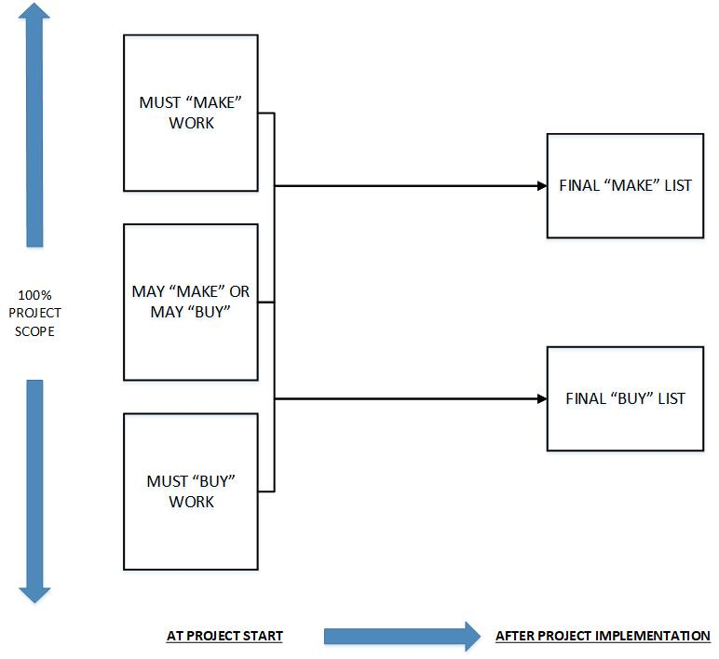
Make or Buy Analysis
Key Considerations:
Core function/competencies of the firm.
Protect competitive position (Trademark etc)
Secure project scope from competition
Availability and ability of Resources
A Study of American firms reveal the following:
Management tends to ignore the make-or-buy problem.
2. Many make-or-buy analyses are based on invalid cost comparisons, due to the excessive use of historical data when estimates of future costs should be used.
3. American businesses lose more money in making things that should be bought than in buying things that should be made.
4. Nevertheless, millions of dollars are lost annually by buying items that could be more economically made.

Slide 24
Budgeting & Contract Types
Perform preliminary budgeting for the procurements and develop a financial flow program for the project.
The budgeting may be performed using historical data and basic market surveys.
Identifying the types of financial contracts to be used:
  Fixed Price or Lump –Sum Contracts
  Cost-Reimbursable Contracts
  Time & Material Contracts (T&M)

Slide 25
EXPERT JUDGMENT
Expert judgment is when you call in an expert to get a skilled opinion. It's an estimation methodology for project planning that relies on the expert's opinion to estimate quantitative project details, such as timelines and potential resources

Slide 26
Outputs: Procurement Planning

Slide 27
Output 1: Project Management Pan
What Contract types will be used?
Addressing Risk Management issues
If independent estimates required for evaluation, who will prepare them and when?
Defining the authority of procurement department and the project management team
If standard procurement documents are required (SOPs), where to find them?
How will multiple providers be managed?
How will procurement be coordinated with other project aspects, such as scheduling and performance reporting?
Handling Make or Buy
Maintaining the WBS
Form and format for procurements
Identify the pre-qualified seller (if available)

Slide 28
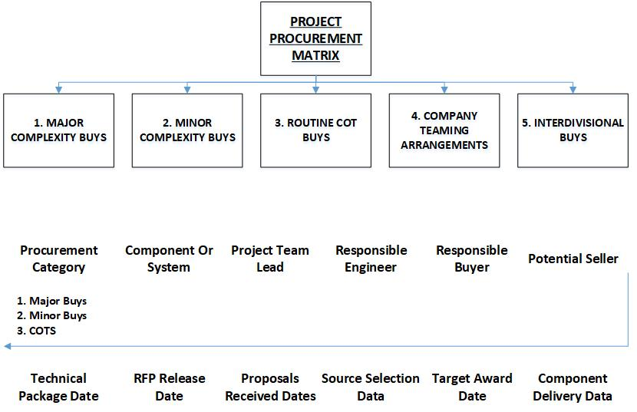
Output 2: Procurement Matrix

Slide 29
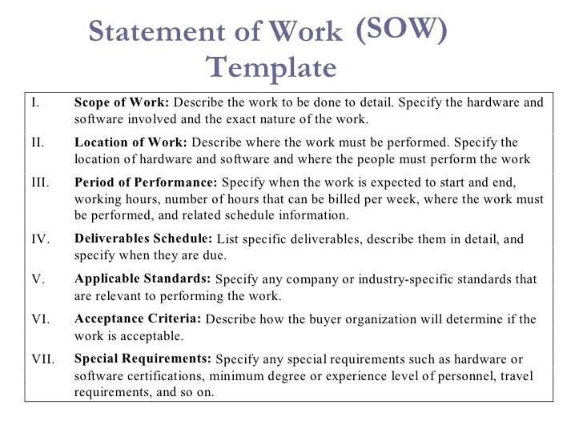
Output 3: Procurement Statement of Work

Slide 30
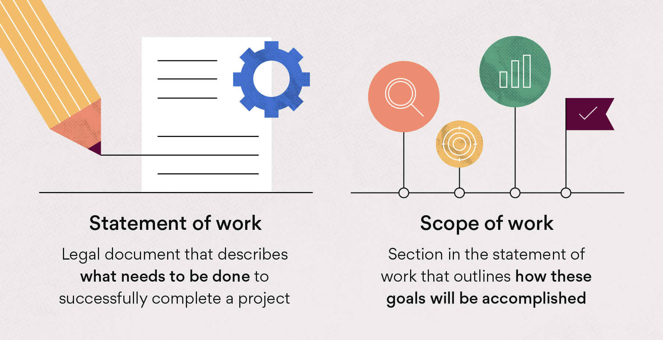

Slide 31
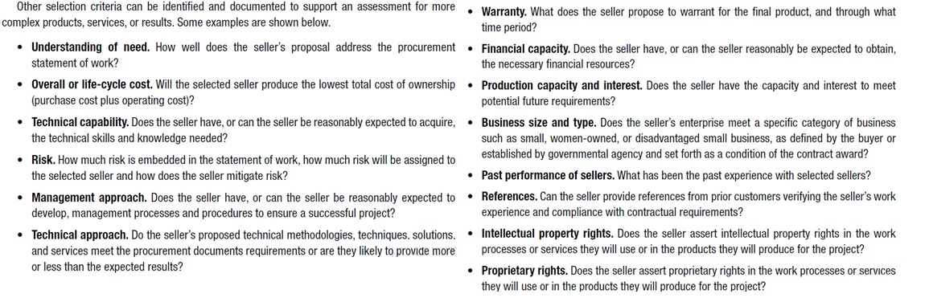
Output 4: Source Selection Criteria

